Slide 1
Online Attendance & Billing System
Board of Intermediate & Secondary Education
Rawalpinidi
Attendance of Candidate , Supervisory Staff
&
Supervisory Staff Billing

Slide 2
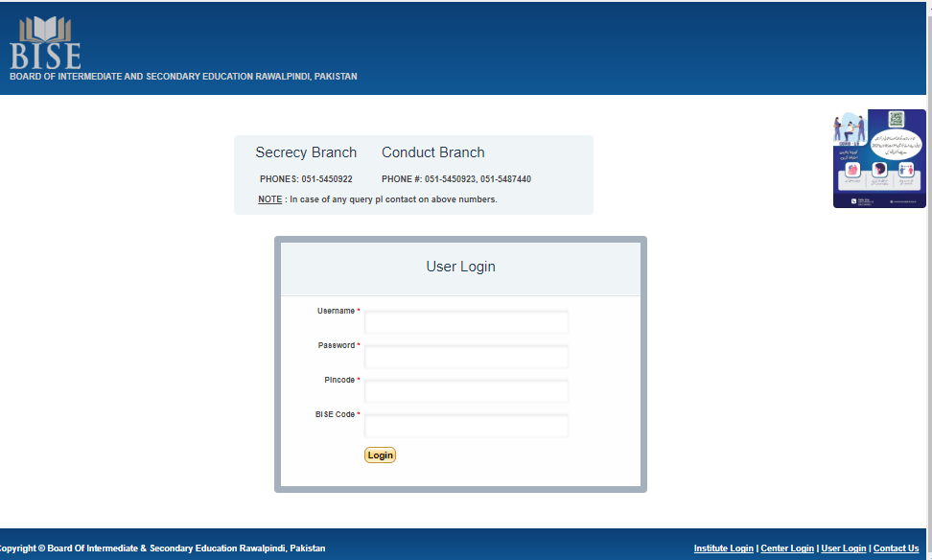
bisesecrecy.com
Center Login

Slide 3
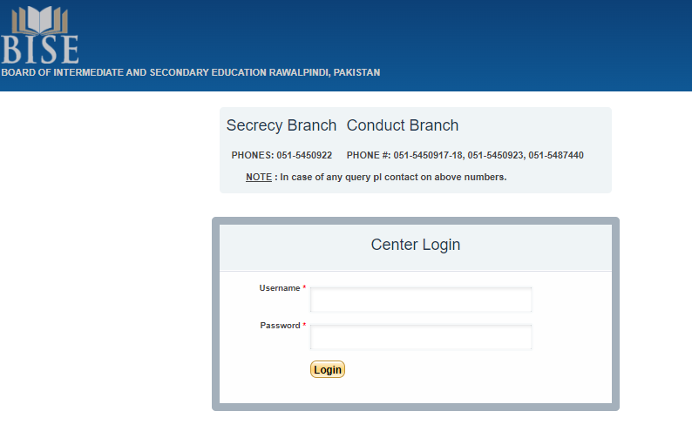
Center Login
Conduct Branch send you by whatsapp

Slide 4
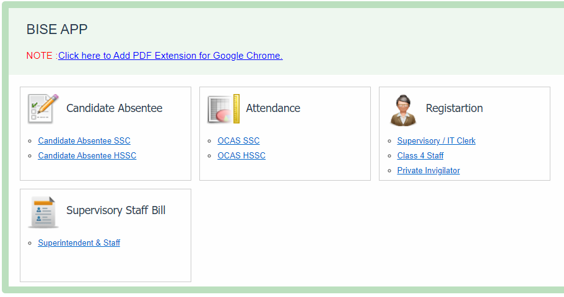
Dashboard

Slide 5
Supervisory staff Registration

Slide 6
Online Registration of Supervisory Staff In Examination Center
Step 1 :
Enter online form of following staff by IT Clerk:
Resident Inspector
Superintendent
Deputy Superintendent
Addition Deputy Superintendent
All Invigilators
IT Clerk
Class-4 Staff (Daftari, Chokidar & Sweeper)

Slide 7
Online Staff Registration Information Submit to Conduct Branch
Step 2 :
Apply Online Duty:
After online registration of all the staff present in examination center, IT Clerk inform Conduct Branch so that the Conduct Branch assign their online duties.

Slide 8
Online Registration

Slide 9
CANDIDATE ABSENTEE SYSTEM

Slide 10
Candidate Absentee
Step 1 :
Enter Candidate Roll No. and click Absent button
Step 2 :
Click link (Print Absentee Report) to create / print PDF Report

Slide 11
Online Registration

Slide 12
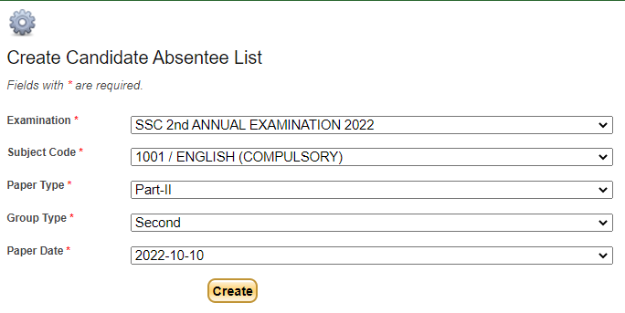
Select Options

Slide 13
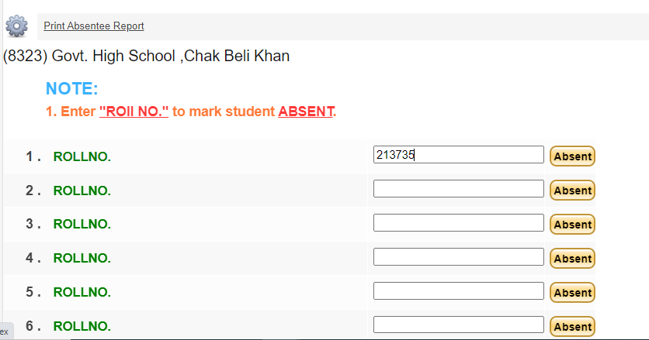
Enter Roll no of absent candidates
Enter Roll no
Click Button to save absent student

Slide 14
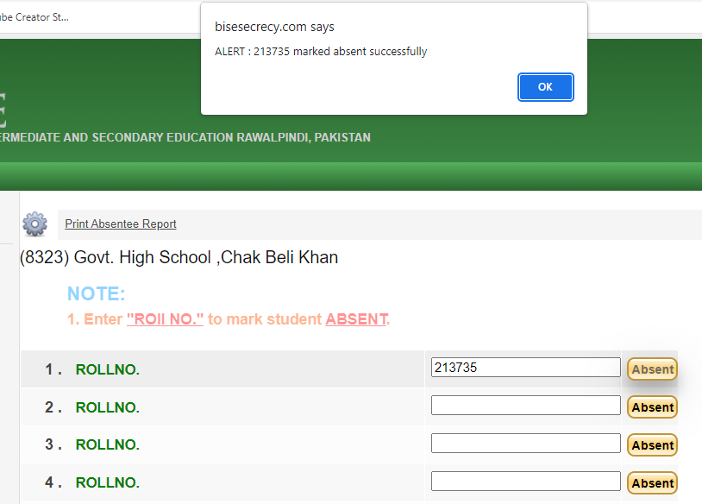
Show Alert

Slide 15
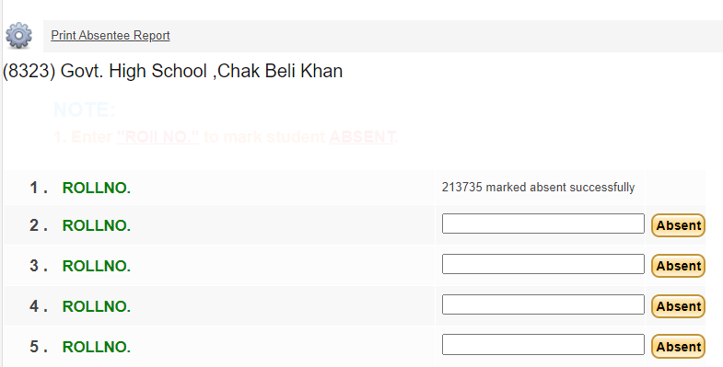
Candidate Mark Absent successfully
Click here to print report
Show message

Slide 16
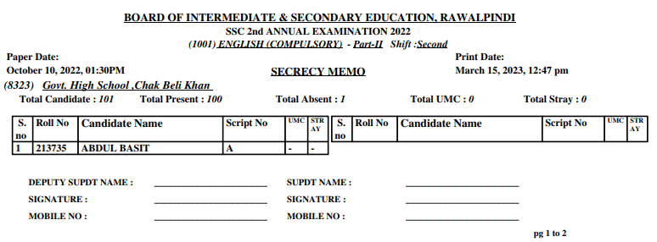
PDF Report

Slide 17
CANDIDATE / Supervisory staff absentee SYSTEM

Slide 18
Candidate Attendance System
Step 1 : Enter Candidate Absentee
(Note: existing entries already visible here)
Step 2 : Enter Candidate Answer Sheet Number
Step 4 : Enter UMC (if any)
Step 5 : Enter Stray Case (if any)
Step 6 : Enter Candidate Sitting Plan (Halls or Rooms)

Slide 19
Supervisory Staff Attendance
Step 6 : Enter Supervisory Staff Attendance by clicking on the check box.
Step 7 : Take print out of the overall PDF Report and sign by relevant personal.

Slide 20
Attendance System

Slide 21
Select Options

Slide 22
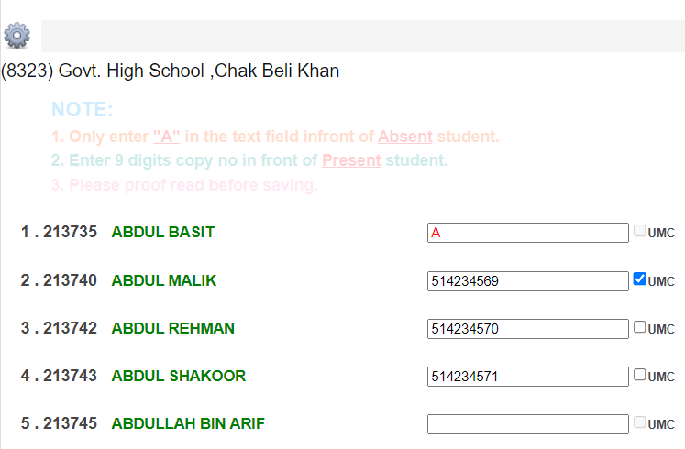
Enter 9 digit Answer Sheet No.
Click checkbox (UMC)
(if any)
Enter 9 digit Answer Sheet No.

Slide 23
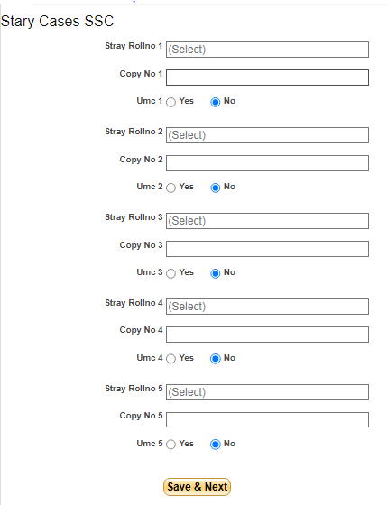
Enter Stray Cases (if any)

Slide 24
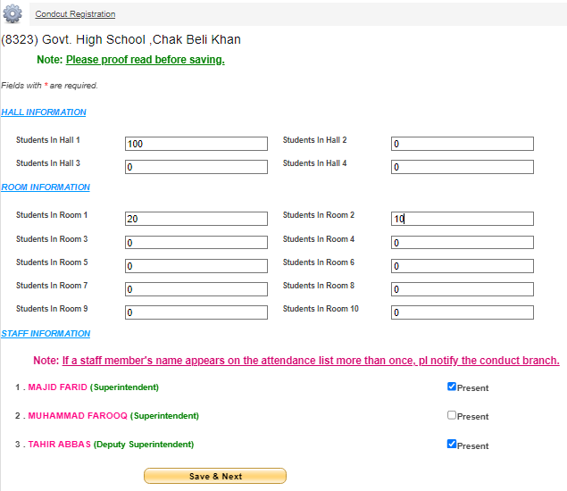
Enter Sitting Plan & Supervisory Attendance
Enter Sitting Plan
Click Checkbox for Present Staff

Slide 25
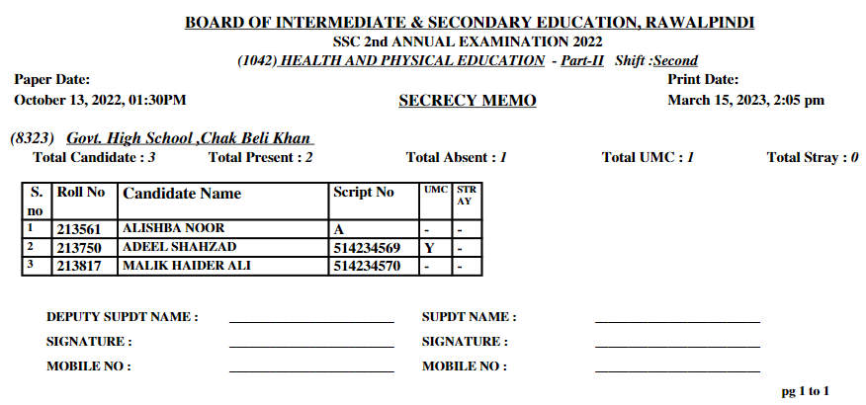
Print Overall PDF Report
Click Checkbox for present staff

Slide 26
Print Overall PDF Report

Slide 27
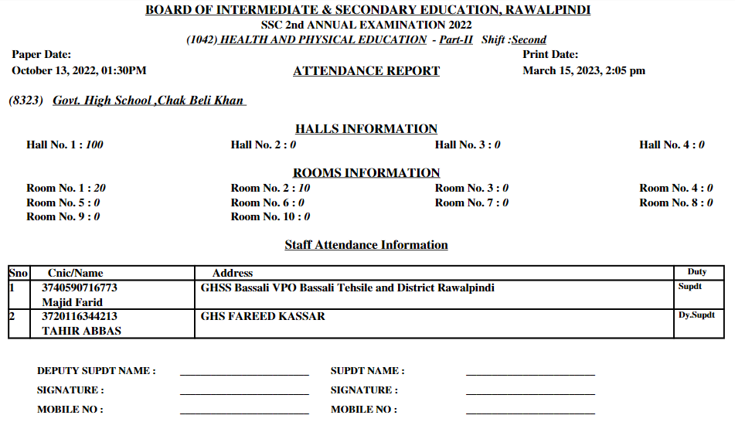
Print Overall PDF Report

Slide 28
Supervisory staff bill generation

Slide 29
Attendance System

Slide 30
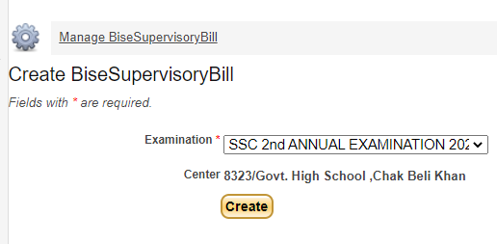
Select Exam

Slide 31
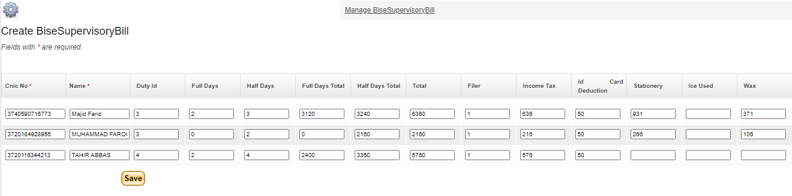
Cretae Bill

Slide 32
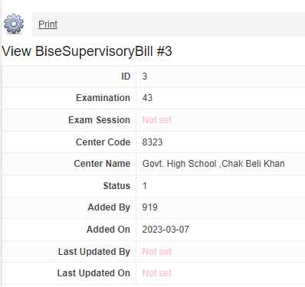
Print Supervisory Bill
Print Bill

Slide 33
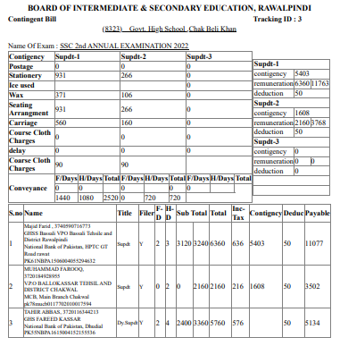
Print Supervisory Bill

Slide 34
Thank you !

